Slide 1
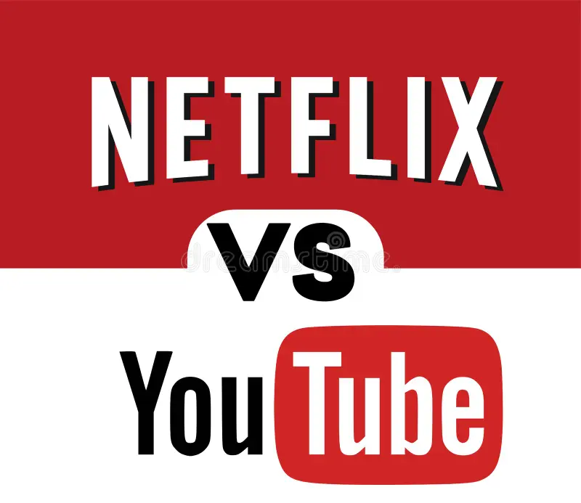
Netflix vs YouTube: Global Popularity Trends During the COVID-19 Pandemic (2019–2021)
FR
FABRIKAM RESIDENCES
Big Data Analytics Capstone Project BY: RUREBWAYIRE Ampoze Ariella
ID:27640
ON: 01/08/2025

Slide 2
Problem Statement
This project analyzes global search interest in Netflix and YouTube from 2019 to 2021 using Google Trends data. The goal is to understand how user attention shifted during the COVID-19 pandemic, and which platform captured more global interest.

Slide 3
Dataset Overview
Source: Google Trends
Format: Weekly interest scores (0–100 scale)
Columns: Week, Netflix, YouTube
Period: December 2018 – December 2021
Tool used for analysis: Python (for cleaning), Power BI (for visuals)

Slide 4
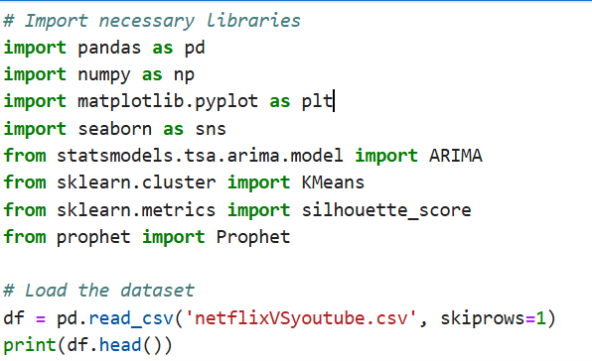
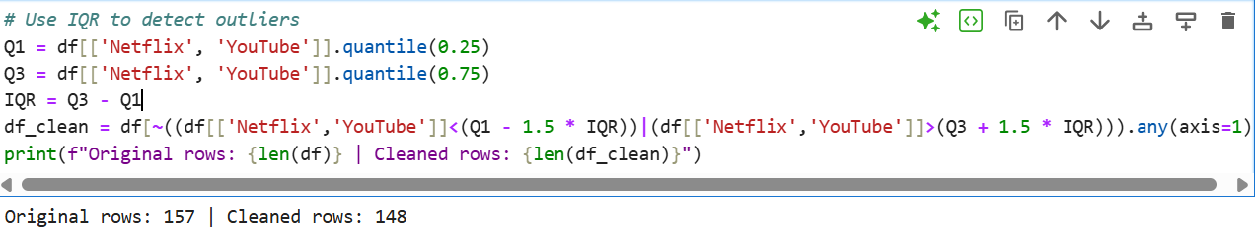
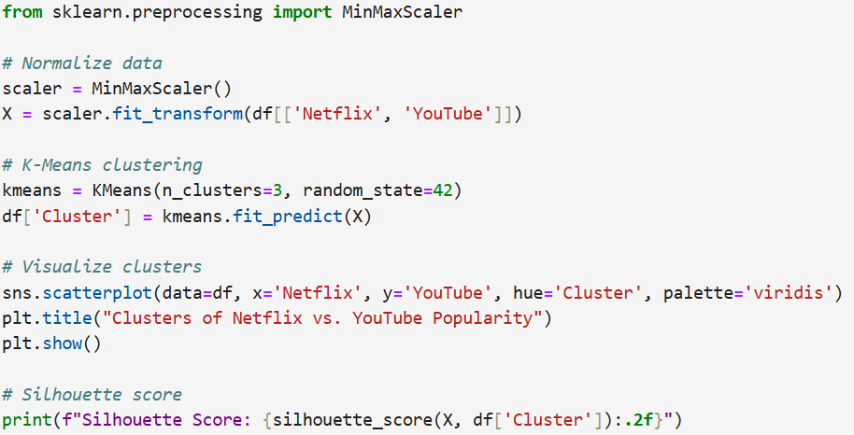
Methodology
Data was cleaned and formatted using Python.
Time-series visualizations were created in Power BI.
Created a custom Competition Index to compare platforms.
Applied K-Means Clustering to discover trend patterns
Visualized yearly trends and platform gaps

Slide 5
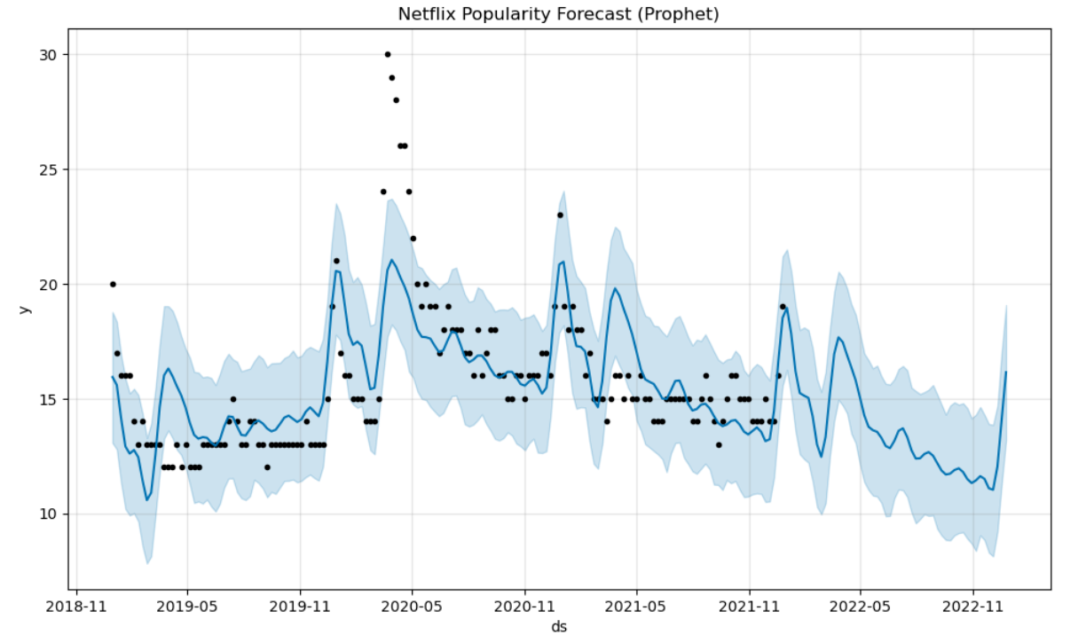
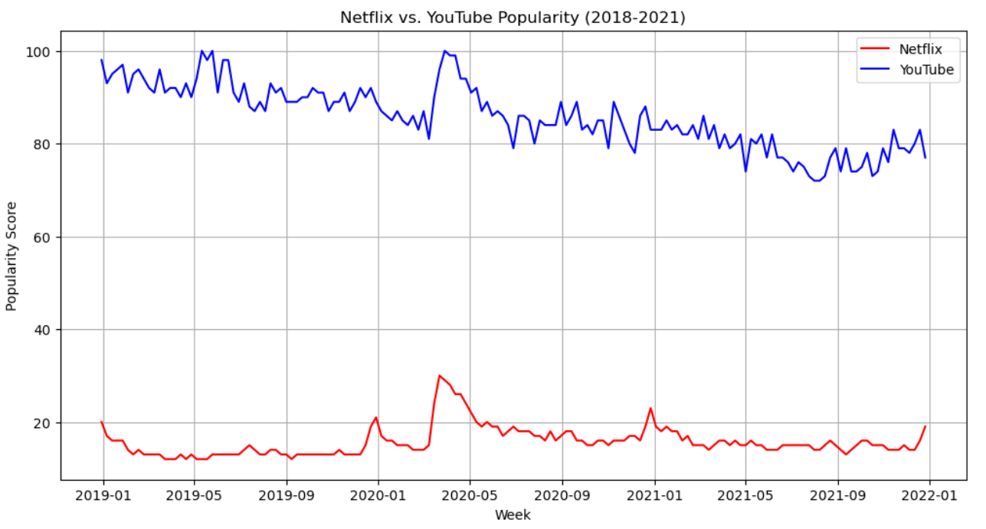
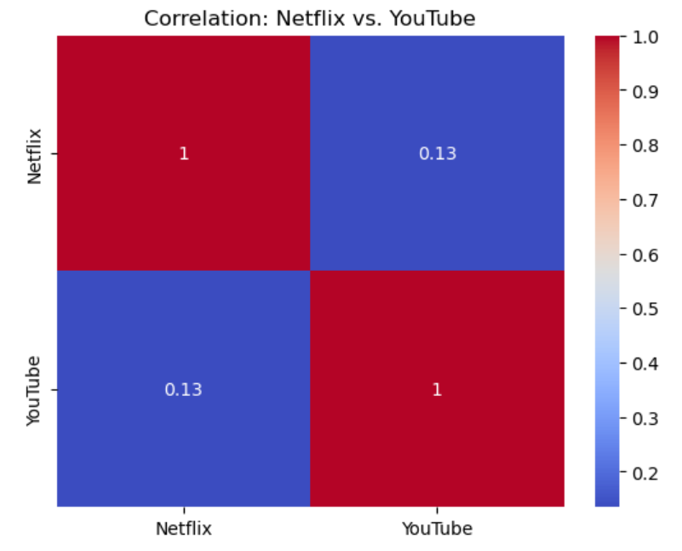
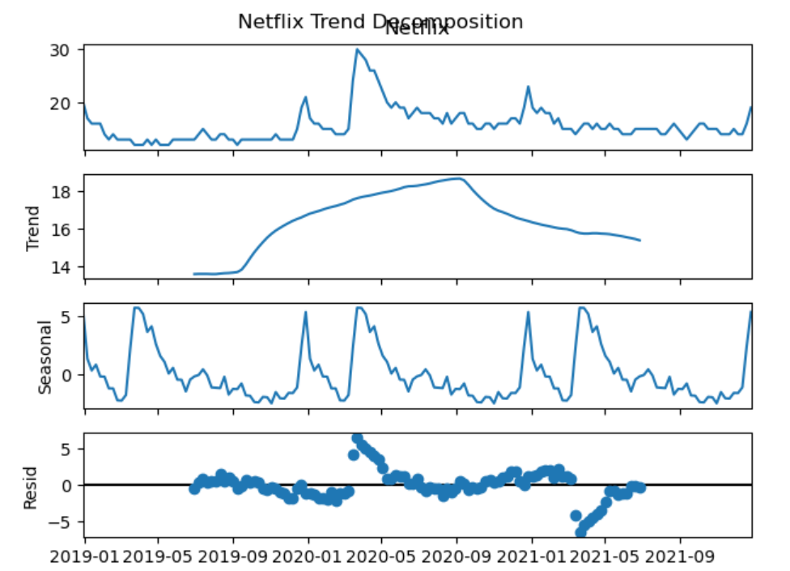
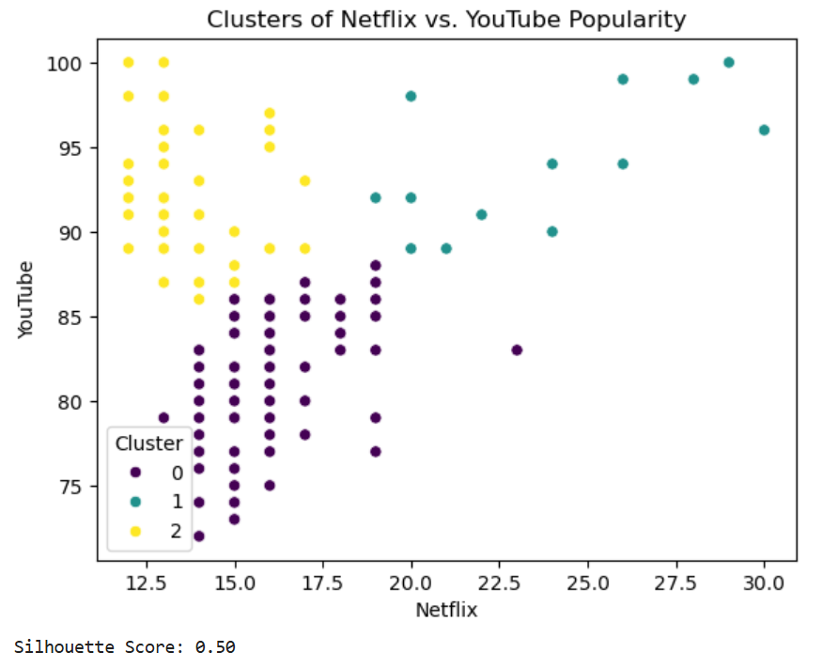
Key Visualizations

Slide 6
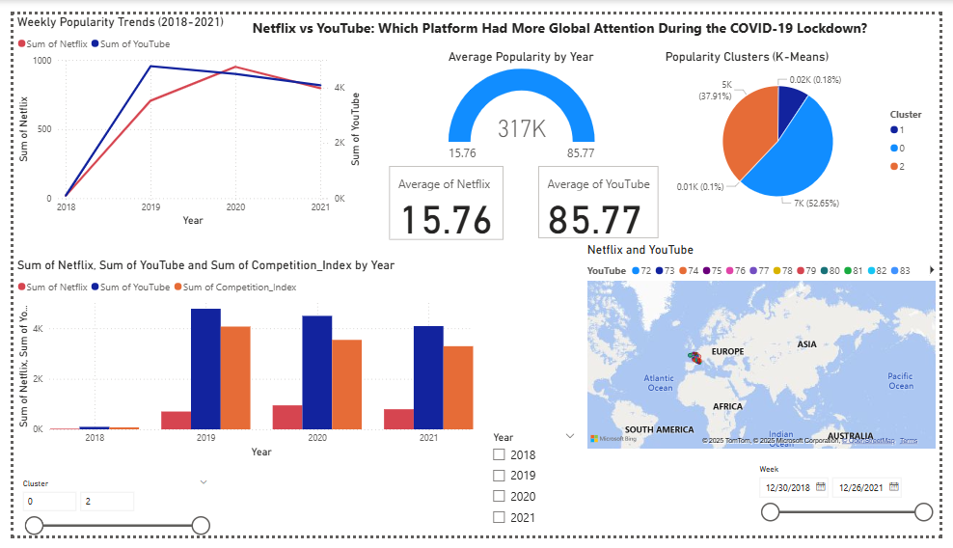
MY DASHBOARD

Slide 7
Findings & Insights
YouTube dominated attention across all years.
Netflix saw its biggest rise in 2020 during lockdown.
France had the highest data visibility in the map.
Competition Index shows the gap narrowed in 2021.

Slide 8
Conclusion
The project revealed how global entertainment preferences shifted during a global crisis. YouTube maintained consistent dominance, while Netflix surged during periods of high demand for on-demand streaming.

Slide 9
THANK YOU!!

